Slide 1
757 RUG – Machine Learning
2017.06.20 – Dan Ross-Li

Slide 2
Outline
Agenda
Congrats! Some Great News
New NDS/RUG Outline
Facebook Prophet
I Can R, and So Can U

Slide 3
News and Updates
Jobs Jobs Jobs
Steve Mortimer – UVA Darden
Josiah Baker – Amazon: Data Scientist
Deb Martin – VPA: Data Scientist
Chris Brossman – Lessa: Director Data
Source: Wikipedia

Slide 4
And the new head is….
Dan Ross-Li – Forecasting =(.
Source: Wikipedia

Slide 5

Now what?
Source: Wowwiki

Slide 6
New NDS/RUG Outline
Work Work Work
RUG and NDS are merging!
Week 1: NDS
Review Results
Introduce New Data Set
Week 3: RUG
Introduce Tools that Compliment the Data Set
Week 3/4: Coffee and Code
Collaboratively Work on the Data Set
End of Month: Submit Data Set

Slide 7
What We Need From You
C C C
Collaboration
Work Together
Ask for code
Open your code
Commitment
Come to Events
Work after Events
Community
Submit Data Sets
Get on Slack – norfolkdatasci.slack.com
Get on Github - https://github.com/NorfolkDataSci

Slide 8
Facebook Prophet
https://facebookincubator.github.io/prophet/docs/quick_start.html#r-api
All info taken from Facebook Github
https://facebookincubator.github.io/prophet/docs/quick_start.html#r-api

Slide 9
Facebook Prophet
https://facebookincubator.github.io/prophet/docs/quick_start.html#r-api
What is Prophet?
Time Series Decomposition
Similar to STL, STLPlus, Decompose
What’s Different?
Integrates ggplot2
Very simple user interface
Integrates forecast
https://facebookincubator.github.io/prophet/docs/quick_start.html#r-api

Slide 10

Facebook Prophet
https://facebookincubator.github.io/prophet/docs/quick_start.html#r-api
https://facebookincubator.github.io/prophet/docs/quick_start.html#r-api

Slide 11
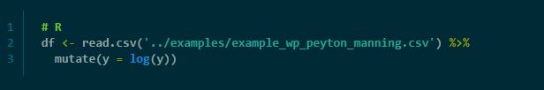
Facebook Prophet
https://facebookincubator.github.io/prophet/docs/quick_start.html#r-api
https://facebookincubator.github.io/prophet/docs/quick_start.html#r-api

Slide 12

Facebook Prophet
https://facebookincubator.github.io/prophet/docs/quick_start.html#r-api
https://facebookincubator.github.io/prophet/docs/quick_start.html#r-api

Slide 13
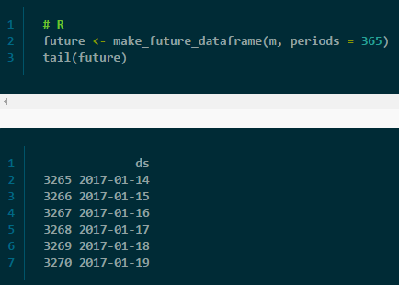
Facebook Prophet
https://facebookincubator.github.io/prophet/docs/quick_start.html#r-api
https://facebookincubator.github.io/prophet/docs/quick_start.html#r-api

Slide 14
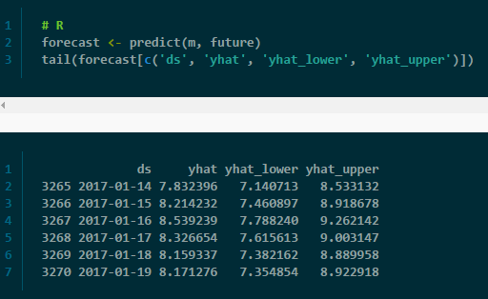
Facebook Prophet
https://facebookincubator.github.io/prophet/docs/quick_start.html#r-api
https://facebookincubator.github.io/prophet/docs/quick_start.html#r-api

Slide 15
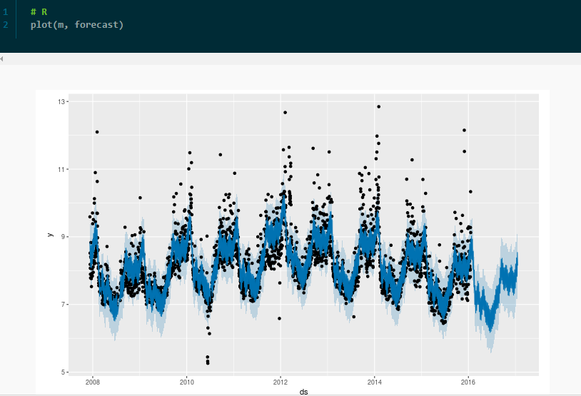
Facebook Prophet
https://facebookincubator.github.io/prophet/docs/quick_start.html#r-api
https://facebookincubator.github.io/prophet/docs/quick_start.html#r-api

Slide 16
Resources
Many Places to Learn and Practice
W3Schools - http://www.w3schools.com/sql/
Hacker Rank - https://www.hackerrank.com/domains/sql/select
SQL Zoo - http://sqlzoo.net/wiki/AdventureWorks
Codecademy - https://www.codecademy.com/learn/learn-sql
Other Norfolk Data Science Members!
Experienced SQL users are all around you

Slide 17
Questions
We’re Here to Help
In Person - Ask Now!
Via Chat - Join the Norfolk Data Science Community on Slack
http://norfolkdatasci.herokuapp.com/
Via Email
Steve - reportmort@gmail.com

